Slide 1

FastLane Motors
Created by:
Prajval Patel - C0911611
Urvesh Patel - C0903445
Sahil Hamirani - C0911606
Akshaybhai Busa - C0908498

Slide 2

Project Overview
Objective: Seamless experience for the
clients to inquire about the cars available in stock.
Stack: MERN Stack.
Structure: Follows client-server architecture.

Slide 3
Backend: Overview
Core Functionality
APIs:
GET /api/cars: Retrieve all car records.
GET /api/cars/:id: Fetch details of a single car by ID.
POST /api/cars: Create new car records with image uploads.
PUT /api/cars/:id: Update existing car records.
DELETE /api/cars/:id: Remove car records from the database.
Technologies Used:
Node.js for server runtime.
Express.js for RESTful routing.
MongoDB for database operations.

Slide 4
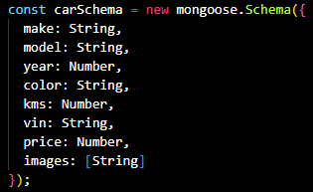
Backend: Data Handling
Car Schema
Fields:
make, model, year, color, kms, vin, price
images: Stores paths to uploaded images.
Validation:
Ensures all required fields are populated before database entry.
Middleware
Multer: Handles image uploads and saves paths dynamically.
Body-parser: Parses incoming JSON data.
Error Handling
Centralized error responses with meaningful HTTP status codes.

Slide 5
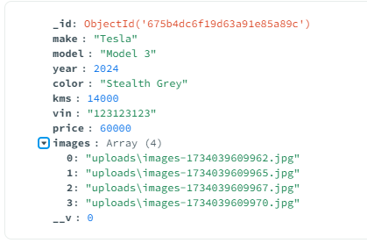
Backend: File Handling
Deployment
Static Files:
Serves uploaded images via /uploads directory.
Library Used:
Multer
https://www.npmjs.com/package/multer

Slide 6
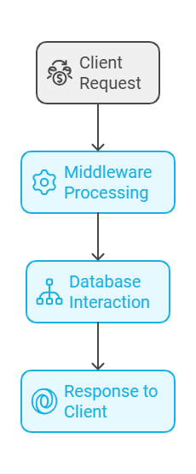
Backend: API Workflow
Typical Workflow
Client Request:
Frontend sends API calls (e.g., POST /api/cars).
Backend Processing:
Middleware validates and processes requests.
Controllers interact with the database via the schema.
Database:
MongoDB stores and retrieves data.
Response:
Backend sends structured JSON responses to the client.

Slide 7
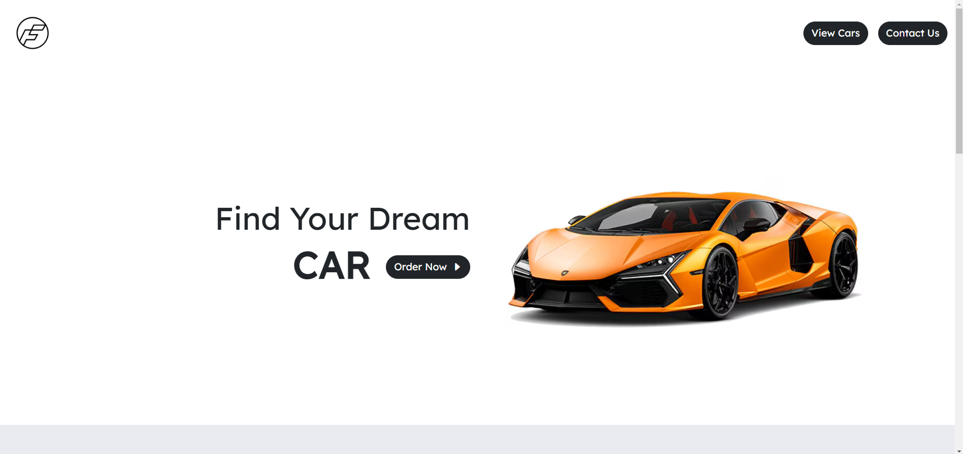
Frontend: Landing Page
Features
Hero Section: Highlights featured cars.
Brand Showcase: Displays brand logos dynamically.
Car Listings:
Fetches car data from API.
Displays featured cars with prices and details.
User Navigation:
Buttons to explore products and contact sections.
Technologies Used
React.js: Component-based structure for dynamic rendering.
Bootstrap: Responsive design and styling.

Slide 8
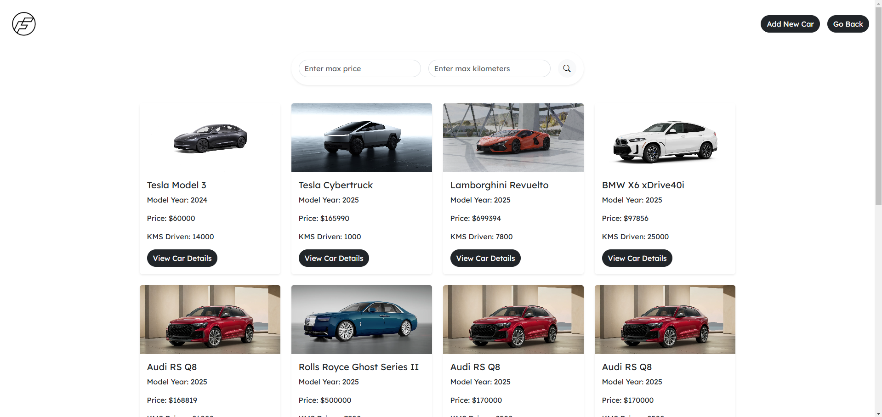
Frontend: Products Page
Features
Car Listings:
Dynamically fetches car data from the backend.
Filters by price and kilometers driven.
Filter Implementation:
Real-time filtering with user-friendly input fields.
Navigation:
Links to individual car details pages.
Technologies Used
Axios: For API calls.
React Hooks: To manage state and side effects.

Slide 9
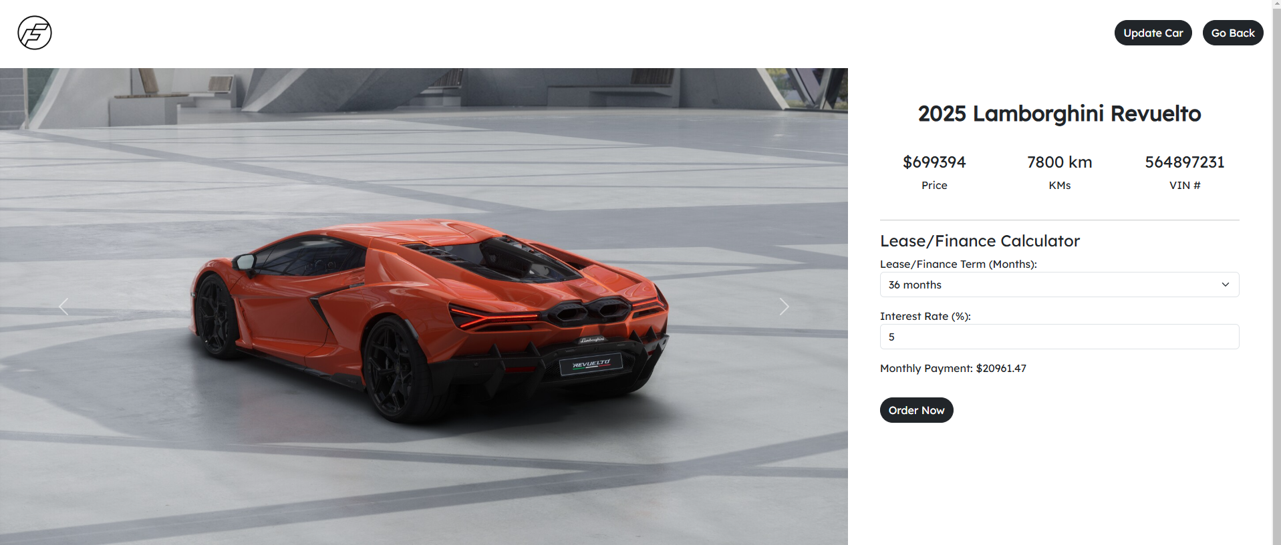
Frontend: Car Details Page
Features
Carousel:
Displays car images.
Uses Bootstrap’s built-in carousel functionality.
Lease/Finance Calculator:
Computes monthly payments dynamically.
Order Now:
Interactive button with modal confirmation.
Technologies Used
React Router: For dynamic page routing.
Bootstrap: For carousel and modal features.

Slide 10
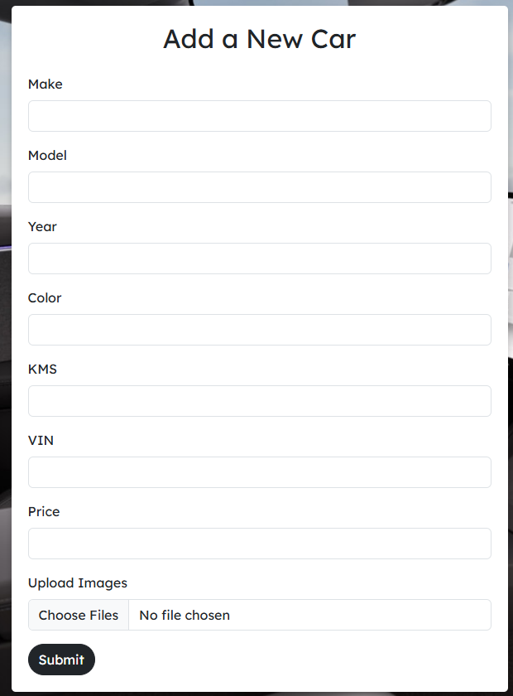
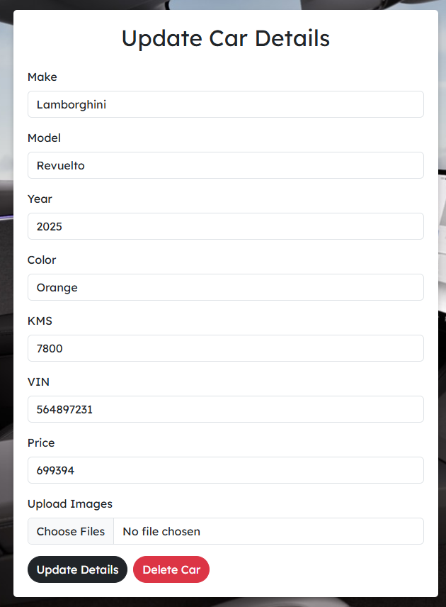
Frontend: Add/Update Car Page
Features
Dynamic Form:
Handles car creation and updates.
Allows multiple image uploads.
CRUD Operations:
Sends data to API for creating, updating, or deleting cars.
Form Validation:
Ensures all required fields are correctly populated.
Technologies Used
React.js: Dynamic state management.
Axios: For HTTP requests.
Bootstrap: Styling and responsive layout.

